Slide 1
Design of face detection and recognition system to monitor students during online examinations
MENTOR
Dr. K.Kumar, Assistant Professor
TEAM -12
Divya A(1817116)
Hafeeza Begum M (1817118)
Keerthana K(1817123)
Pavithra T(1817137)

Slide 2
PROJECT FLOW
Design of face detection and recognition system to monitor students during online examinations
Step 1 : Student Verification
Step 2 : Monitor students during examination
SOLUTION (Step 1):
Student verification done using face detection and face recognition .
Face detection -> Identify the face present in the image .
Face Recognition -> Way of confirming the student identity using their face .
SOLUTION (Step 2):
Create an automated proctoring system where the user can be monitored automatically through the webcam . Monitoring the user’s eye movement , mobile phone usage detection , identify the presence of person other than user.

Slide 3
PROCESS FLOW - Step 1
Student Verification Process
Input Image
Face Detection
Face Segmentation
Features Extraction
Matching of Faces
With Trained Database
Report Generation

Slide 4
PROCESS FLOW - Step 2
Student Monitoring Process
Eye Tracking
Seperate Process
Person Counting
Mobile phone Detection

Slide 5
Why MTCNN ?
Algorithms | Drawbacks
Haar Cascade | Do not provide best accuracy.
DNN Face Detector | Does not detect small faces as it is trained for minimum face size of 80×80.
Dlib Frontal Face Detector | Does not fit for non frontal facing faces .

Slide 6
MTCNN Algorithm
MTCNN - Multitask Cascaded Convolutional Neural Networks
It detects faces and facial landmarks on images.
Advantages over other Algorithms
Speed – Prediction step takes around 0.005 secs for 11.5 FPS
Accurate - It should only detect faces (no false positives) and detect all faces (no false negatives)
Robust - Faces should be detected in different poses, rotation, lighting conditions .
Utilizing all available resources - using GPU if possible, using color (RGB) input etc.

Slide 7
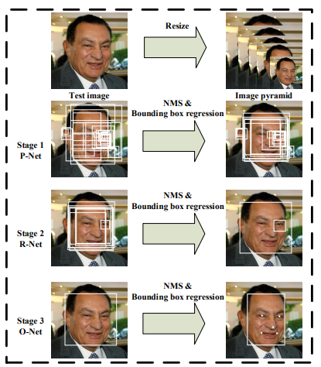
MTCNN Architecture
It takes the image and resize it to different scales inorder to build an image pyramid which is input to the three Staged cascading network.
Three convolution networks:
1.P-NET ( Proposal network )
2.R-NET ( Refine network )
3.O-NET (Output network )
Application:
SELF-Driving cars : This algorithm is used to identify the objects present in front of the moving car by using R-Net it shows the Identified object in the bounding box .

Slide 8
PROCESS FLOW – Module 1
Face Detection Process
Input Image
Detected image with Bounding box and
Facial Points
MTCNN Algorithm
Bounding Box Creation
Facial Landmarks Detection

Slide 9
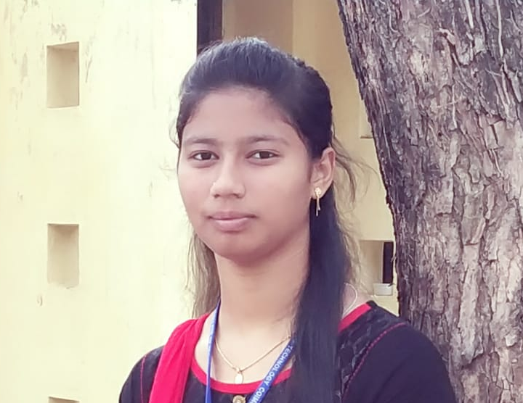
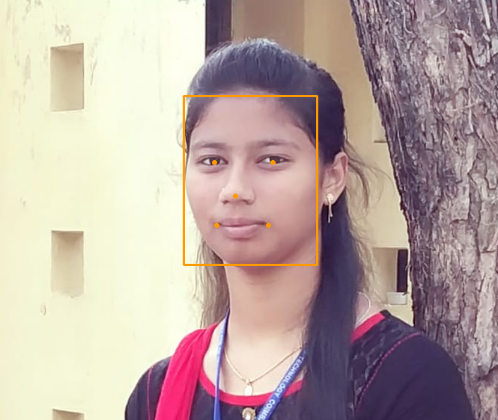
Face Detection Implementation
Input Image
Face Detected Image
Bounding Box
5 Facial key points

Slide 10
PROCESS FLOW – Module 2
Face Verification Process
Input Image
MTCNN Algorithm
Feature Extraction
Yes
No
Image Comparison using
Cosine similarity
(Value <0.5)
Face
Not Matched
Face Matched
Face Verification done

Slide 11

Face Verification Implementation
Input Image
Hafeeza.jpg
Hafee.jpg

Slide 12


Face Verification Implementation
Extracted Image
Hafeeza.jpg
Hafee.jpg

Slide 13
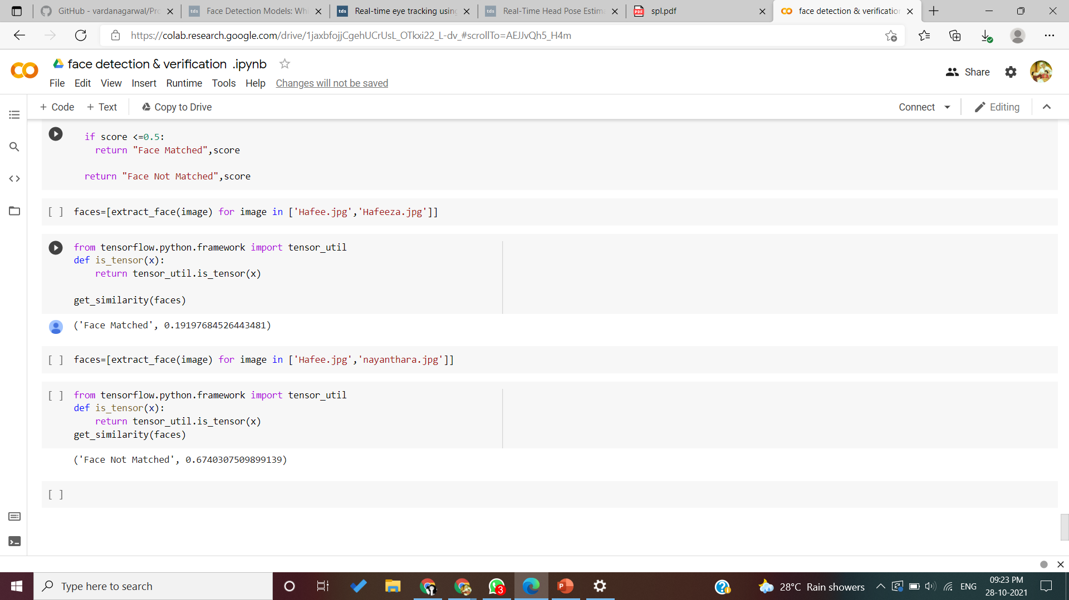
Face Verification Implementation
Comparison of Extracted Image
Cosine Similarity
Conclusion :
Cosine similarity<0.5 -> True (0.19197…)
Face Matched
Hafeeza.jpg
Hafee.jpg

Slide 14
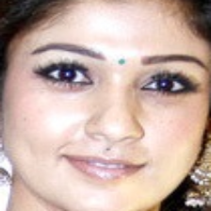
Face Verification Implementation
Comparison of Extracted Image
Cosine Similarity
Conclusion :
Cosine similarity<0.5 -> False (0.6740…)
Face Not Matched
Hafee.jpg
nayanthara.jpg

Slide 15
Further Modules
Eye Tracking Module
Eye tracking module is to track eyes during examination . It is achieved by using Dlib Frontal Face Detector and facial key point detector.
Black mask -> Finding Eye Area.
Binary mask -> Segment out the eye ball from the Eye.
Person Counting and Phone Detection Module
Person counting is process of find and identifying more than one human face in the monitoring screen.
YOLOv3 with TensorFlow and OpenCV
Instance segmentation -> detect distinct person appearing the monitor
Anchor Box -> Detect the mobile phone usage along with person detection.

Slide 16
Reference
M. Geetha, R. S. Latha, S. K. Nivetha, S. Hariprasath, S. Gowtham and C. S. Deepak, "Design of face detection and recognition system to monitor students during online examinations using Machine Learning algorithms," 2021 International Conference on Computer Communication and Informatics (ICCCI), 2021, pp. 1-4, doi: 10.1109/ICCCI50826.2021.9402553.
K. Zhang, Z. Zhang, Z. Li and Y. Qiao, "Joint Face Detection and Alignment Using Multitask Cascaded Convolutional Networks," in IEEE Signal Processing Letters, vol. 23, no. 10, pp. 1499-1503, Oct. 2016, doi: 10.1109/LSP.2016.2603342.
Rohan Naik, Kalpesh Lad, 2015, Face Recognition from Multi Angled Images, INTERNATIONAL JOURNAL OF ENGINEERING RESEARCH & TECHNOLOGY (IJERT) Volume 04, Issue 02 (February 2015),
Secure Online Payment with Facial Recognition using MTCNN Ms. Aria , Mr. Varun Agnihotri , Mr. Ankit Rohra, Mr. Rohit Sekhar , International Journal of Applied Engineering Research ISSN 0973-4562 Volume 15, Number 3 (2020)

Slide 17
Thank You

